Slide 1
Drugs Box & Robotic pharmacy Patient services ultimate edition robot
Jordan university of science and technology
Supervised by:
Dr.OSAMA AL-KHALEEL
Team members:
Ibrahim Baker Gharaibeh
Baha Ahmad GDIESAT
Khaled Ahmad Hinde
Anas Jaffar Bani-Hamad

Slide 2
Outlines:
Abstract & Background.
project description.
Project Approval.
Project purposes & objectives.
Project Stockholders.
Proposed Work.
Feasibility Study and Constraints
Project assumptions

Slide 3
Outlines:
Project life span.
Methodology used.
Technical process plan and methods used.
Roles and Responsibilities.
ANALYSIS PHASE.
Functional Requirements of the software.
Logic modeling & Decision Table.
Project Scheduling and Major milestones.
Standards followed.
Risk Management

Slide 4
Abstract & Background
Reduce the number of routine necessary moves.
Increase the productivity of the work.
Reduce time & effort to allow nurses to focus more on the patient.
Prevent the medications from being stolen.
Using smart phones , android os , arduino board, the box hardware and the conveyor belt we are trying to reduce the above problems.

Slide 5
project description:
the doctor of the hospital will enter the information of the patients.
Ex: patient name, medication name , medication amount/quantity , medication time.
the software will keep checking until the time come for the patient to take his medications.
the software well send a note to the hardware box/room to inform it when the time comes for the patient to take his medications.

Slide 6
project description cont.
the hardware room/box should drop the medication on the conveyor belt.
the conveyor belt should take the medications to the patient.
the app alert the patient that the medicine is ready.

Slide 7
Project Approval
This Project was approved by:
# chancellor of the IT : < Professor Ali Shatnawie >
# Head of the Software Eng. Department :
<Doctor Loay Alawneh>
# Head of the Computer Eng. Department :
< Professor Moath jarrah>
# Head of the Network Eng. Department : < Professor Eyad Taqi-aldeen> and the approval of the supervisor < Doctor Osama Al-KHALEEL>

Slide 8
Project purposes & objectives:
reduce the number of necessary routine moves.
increase the productivity of the work by letting the nurses focus on the patients at all times.
reduce the number of missing medications.
give every patient his medication on the accurate time and amount.
reduce wasted time of the nurses.
Prevent medications from being stolen.

Slide 9
Project Stockholders:
Jordan university of science and technology.
Dr. Osama Al-KHALEEL.
Team members: Bahaa GDIESAT. Khaled Al-Hinde. Ibraheem Al-GHARAIBEH. Anas J. Bani-HAMAD.
System Users:
Doctors. Patients.

Slide 10
Proposed Work
General Used
Drop Drug
Three Times
Table
Container

Slide 11
Components
Hardware :
Arduino UNO R3 Board
HC-05 Bluetooth Module
DS3231 Real Time Clock
Solenoid Slim Lock
Android device

Slide 12

Components Cont’d
Software :
${ARDUINO}^{®}$software (IDE).
C/C++ programming.
Android programming

Slide 13
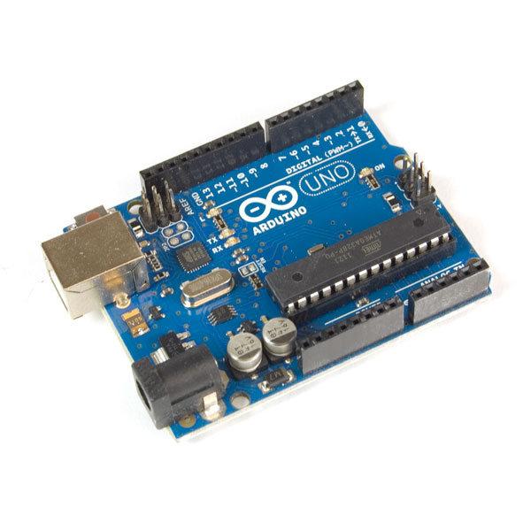
Hardware
Arduino UNOa R3 Board
14 digital input/output pins
16 MHz crystal oscillator
Price :$19.99

Slide 14
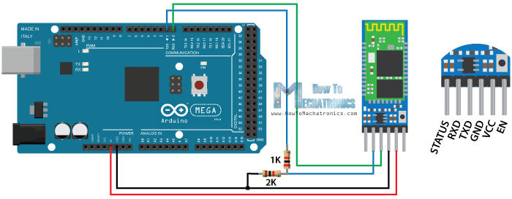
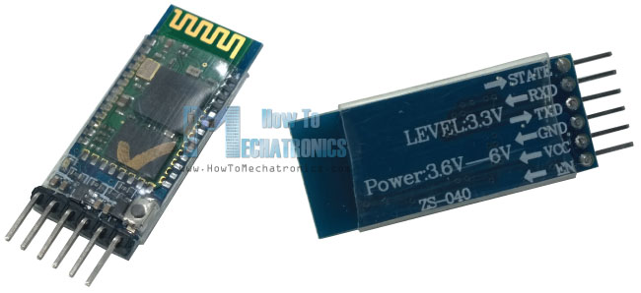
Hardware Cont’d
HC-05 Bluetooth Module
Price : $5.65
Range : approximately 10 Meters

Slide 15
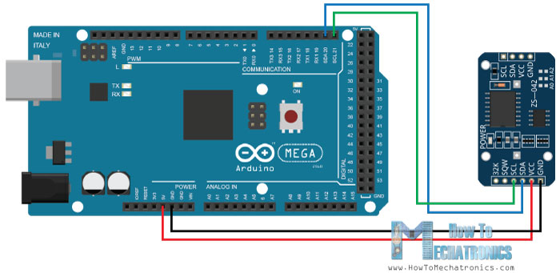
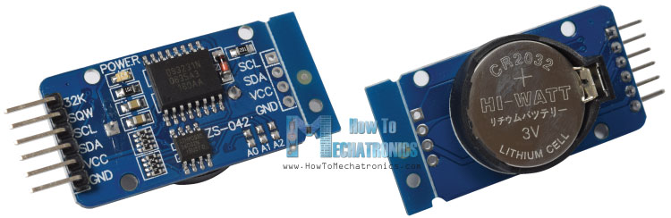
Hardware Cont’d
DS3231 Real Time Clock
incorporates a battery input
Timekeeping when interrupted
Price : $5.99

Slide 16
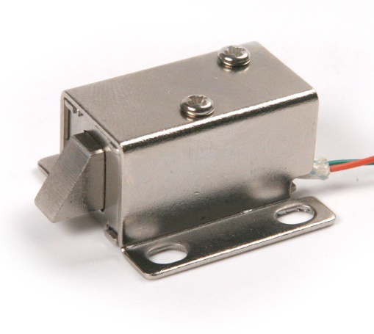
Hardware Cont’d
Solenoid slim lock :
Electronic-mechanical locking mechanism.
Low power consumption
Access control

Slide 17
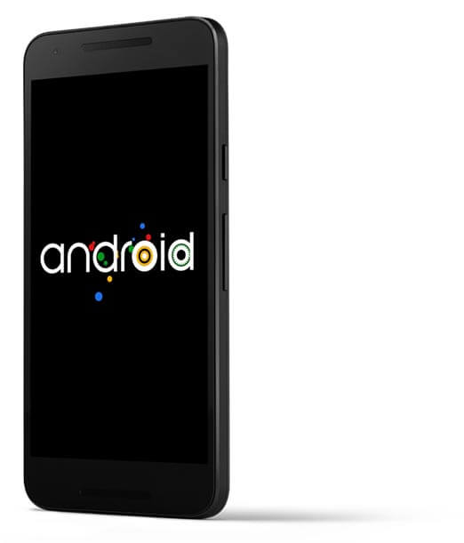
Hardware Cont’d
Android device :
Mobile operating system.
Mobile device that requires an OS :
Smartphone
Tablet PC
e-book reader

Slide 18
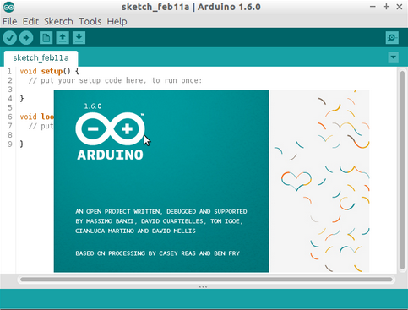

Software
${ARDUINO}^{®}$software (IDE).

Slide 19
Software Cont’d
C/C++ programming :
C programming :
programming language
1970s developed at Bell Labs by Dennis Ritchie
C++ programming :
Object-oriented programming (OOP) language
Developed by Bjarne Stroustrup
Renamed C++ in 1983

Slide 20
Android programming :
we will use Android Studio . SW-Eng Ibraheem prepared for this by taking android course elective in the university and advance android programming course outside the university .

Slide 21
Network part:
public class BluetoothCommuunication {
In this class we have a lot of variables and functions that will help us in make and manage Bluetooth connection and control message delivery between connected devices.
We also need thread to listen to the income connection that coming from master device (android application) to slave device (Bluetooth ship).
public BluetoothCommuunicationService(Context context, Handler handle)
{
first we need BCS(BluetoothCommuunicationService) constructor to establish new Bluetooth data transfer with 2 parameter :
1-Context: the data that exist in each message we call it context
2-handler: send messages to user interface ,
}

Slide 22
Network part:continue
private synchronized void updateUserInterfaceTitle() {
it will change based on connection status that will send it to handler
}
public synchronized int getStatus() {
it’s integer function that will return the status of our connection
}
public synchronized void startConnection() {
we use this function to establish the connection between master and slave
we need to accept on thread that will be on the master(server) side to listen(server mode) on incoming connection request.
So we will cancel each thread that try to connect with our master(android)except our thread
Also we cancel any thread running connection with our master.
Then our thread will start server mode
Finally, we will update UI through handler
}

Slide 23
Continue:
public synchronized void connect(BluetoothDevice device, Boolean secure) {
Start the ConnectThread to establishes a connection to a remote device.
We have 2 parameters :
1-Blutooth Device :we identify here the device that we want to connect with,
2-Sceure :here will determine if our connection if secure or not
If (true)Secure
If(False):not secure }
public synchronized void connected(BluetoothSocket socket, BluetoothDevice
device, final String socketType) {
Start the ConnectedThread to begin managing a Bluetooth connection
socket The Bluetooth Socket on which the connection was made
Cancel the thread that completed the connection
Cancel any thread currently running a connection and cancel the accept thread process , because we only want to connect with one device
run the thread that manage the connection and perform transmissions
Send the name of the connected device back to the UI Activity
To Update UI title through handler }

Slide 24
Continue:
public synchronized void stop() {
Stop all threads
}
public void write(byte[] out) {
Write to the ConnectedThread in an unsynchronized manner out The bytes to write
let’s see ConnectedThread#write(byte[])
we will Create temporary object
then Synchronize a copy of the ConnectedThread
finally we will Perform the write unsynchronized }
private void connectionFailed() {
Indicate that the connection attempt failed, in this situation we will
Send a failure message back to the user interface Activity
Through handler to update user interface title
Then we will Start the service again to restart listen step through our thread }

Slide 25
Continue:
private void connectionLost() {
/*Indicate that the connection attempt lost, in this situation we will
Send a failure message back to the user interface Activity
Through handler to update user interface title
Then we will Start the service again to restart listen step through our thread */
}
private class AcceptThread extends Thread {
/* This thread runs while try to make an outgoing connection
* with a device. Its already runs through; the connection may
* success or fails.*/
}
public AcceptThread(Boolean secure) {
* This thread will run while they are listening for incoming connections. It’s look
* like a server-side client. It runs until a connection is accepted
* (or until refused)
*Create a new listening server socket }

Slide 26
Continue:
public void run() {
//here we try to Listen to the server socket the socket was free( not connected)
// This is a blocking call and will only return on a
// successful connection or an exception
// If a connection was accepted
// Either not ready or already connected. Terminate
}
public void cancel()
{
//close socket on client side }

Slide 27
Continue:
private class ConnectThread extends Thread {
/* This thread runs while trying to make an outgoing connection
* with a device. It’s already runs through; the connection either
* succeed or failed. */
// Get a BluetoothSocket for a connection with the
// given BluetoothDevice }
public void run() {
here we will cancel the discovery process because it will reduce the speed of connection
// Make a connection to the BluetoothSocket
// This is a blocking call and will only return on a
// successful connection or an exception
// Close the socket
// Reset the ConnectThread because we're done
// Start the connected thread }
public void cancel() {
//Close socket on server side }

Slide 28
Continue:
private class ConnectThread extends Thread {
/* This thread already runs through a connection with a remote device.
It handles all incoming and outgoing data
Get the BluetoothSocket input and output streams*/ }
public void run() {
// here we will stay listen to Input stream to receive data from paired device
But we have to share any incoming message with user interface activity through handler
}
public void write(byte[] buffer) {
/*
Write to the connected Out Stream
We write on the buffer (array)
We send a copy of any sent message to user interface (UI) activity */ }
public void cancel() {
Close Bluetooth socket
}}}

Slide 29
Feasibility Study and Constraints
Technical:
Software resources needed to get the Project done meets the need of our project and it can be done (not hard to achieve).
Hardware needed for the box/room is existing as components but need to edit it's functionality a little bit to meet the requirements and the need of the project.
Hardware needed for the Conveyor belt is existing but needs to be controlled from the hardware to meet the requirements of the project.
Network needed to Communicate between the Software and the hardware exists but needs a code and a compression algorithm.
Economy :
Software resources needed to get the Project done are free.
Network needed to Communicate between the Software and the hardware is a Bluetooth chip and its very cheap.
Hardware needed for the Conveyor belt and the box is cheap.
all manpower we need is a SW-Eng and Computer Eng and a Network Eng.
Health and Safety:
any medicine should not be out of its container for more than 24 hours in the temperature it must be stored in.

Slide 30
Feasibility Study and Constraints
Site and Location (environment):
Hospitals.
Home.
Financial:
Users (hospitals): they will realize that the hospital will not need more nurses to service the patients .
organizational (project releases): can sell it at a very high cost but the project does not cost that much for the organization so the project have a high profit for them.
also can sell it for the people so they can use it in their homes which means more profit.

Slide 31
Project assumptions:
# the project manager will divide the tasks evenly between the team members and himself taking into consideration what every team member is good at.
# the team members will submit their done tasks on time as scheduled (in the specified dates).
# the project manager will be taking into consideration the delayed submission of the team members works due to exams , other project ,home works and their Special emergency circumstance (being Humanitarian) when he builds the schedule.
# the work will be done in parallel.
# all the hardware components and the Software needed to build the project will be delivered to us on time as planned.

Slide 32
Project life span (stages/phases) & methodology.
Feasibility
Planning
Requirements analysis
Implementation
Development /design
Launch/Release

Slide 33
Technical process plan and methods used
in the software eng. we are using the Agile method.
# High level of communication between the stockholders and the team members. - Reduce the misunderstanding in Requirements. - Increase the user involvement level.
# Helps to break down the project into smaller parts. - Parallel Processing. - Managed easier by the team leader. - focus on implementation and testing each part. - ease of Error detection and correction. - focus on Quality.
# Adaptable when Requirements change or new Requirements Appear. - new Requirements or change in Requirements can be planned and managed in the next iteration.
# a fast method (decrease the chance of delays and decrease the chance of late in project delivery).

Slide 34
Roles and Responsibilities
Supervisor: Dr. Osama Al-KHALEEL
Project Manager: Ibraheem Al-GHARAIBEH
Project Manager Assistant: Bahaa GDIESAT.
Hardware Architect: Anas Bani-HAMAD Bahaa GDIESAT
Network Architect: Khaled Al-Hinde
Hardware programmer: Anas Bani-HAMAD
Developer: Ibraheem Al-GHARAIBEH
Testers: Bahaa GDIESAT
Anas Bani-HAMAD Khaled Al-Hinde Ibraheem Al-GHARAIBEH

Slide 35
ANALYSIS PHASE:
Required
Devices and Hardware / software / OS .
## Hardware Required : -Smart phone (and supports Bluetooth). -Bluetooth Chip. -a Conveyor belt. -the Box/room components.
## Software Required : - GOOGLE Android Studio. - Arduino BT.
## OS Required :
- Android 5.0.1 or a Higher version of Android Operating System.

Slide 36
ANALYSIS PHASE: (Functional Requirements)
FEAT-1
The System should Allow a the new doctors of the hospital to register throw the head of the hospital username and password .
FEAT-2
The System should Allow the doctors to create a new patient profile.
FEAT-3
The System should Allow the doctors to add/edit patients medications information(time , type and amount).
FEAT-4
The System should Allow the doctors to delete a patient profile .
FEAT-5
The System should Alert the patients when the medications are ready and to turn off that Alert when they command the system to turn it off throw the patient/user interface .
FEAT-6
The System should send a message to the robot inform him about the type, time and the amount of the medicine.

Slide 37
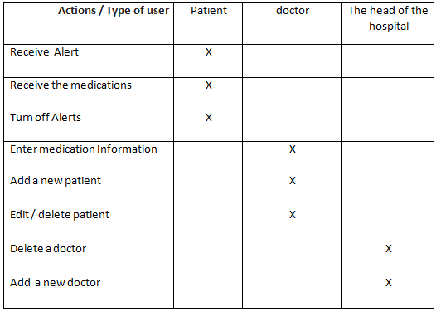
Logic modeling & Decision Table:

Slide 38
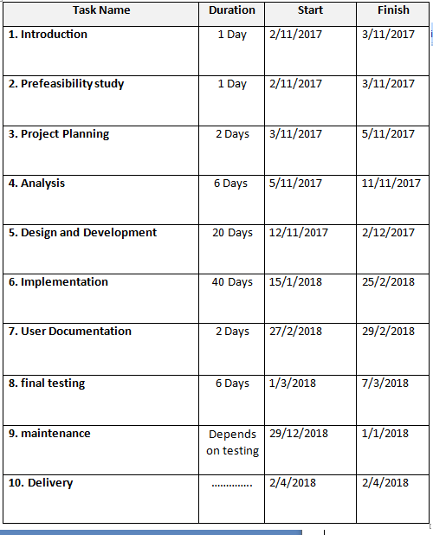
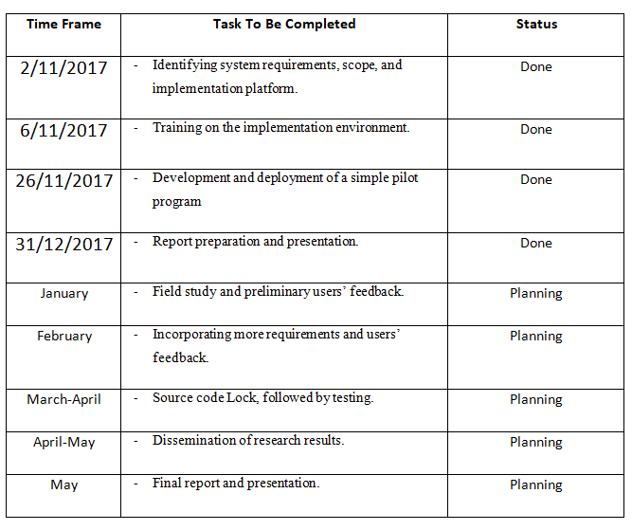
Project Scheduling and Major milestones:

Slide 39
Standards followed:
# weekly meetings - discuss what we have achieved in the previous week. - discuss what we will achieve in the next week. - discuss the problems we have faced in the work. - extra two meetings to combine the work (last two meetings)
# each function and button name must represent its functionality.
# the project manager assistant will take over when the project manager is not in the work/meeting.

Slide 40
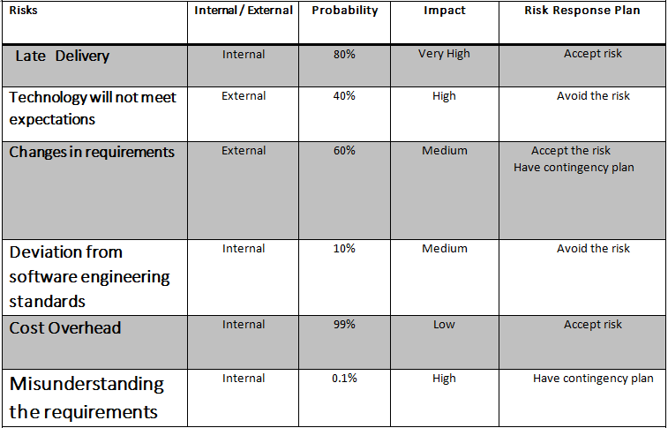
Risk Management:

Slide 41

Questions???

Slide 42
DRUGS BOX
Supervised By:
DR: Osama-Al Khaleel

Slide 43
Supervised By: DR: Osama-Al Khaleel
Presented By
Baha Ahmad GDIESAT
Ibrahim Baker Gharaibeh
Khaled Ahmed Hindi

Slide 44
System Components:
Hardware:
Arduino board Mega
Bluetooth chip Hc-06
Drug Box
Convey Belt
Software:
Android Studio
Arduino IDE

Slide 45
BRief:
the doctor of the hospital will enter the information of the patients.
Ex: patient name, medication name, medication amount/quantity, medication time etc...
the software will keep checking until the time come for the patient to take his medications.
the software will send a note to the hardware box/room to inform it when the time comes for the patient to take his medications.
then the hardware room/box should drop the medication on the conveyor belt.
the conveyor belt should take the medications to the patient.
the app notifies the patient that the medicine is ready

Slide 46
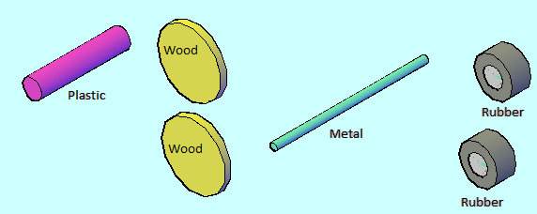
Proposed Work:
we also need1 plastic and 2 Rubbers and 2 woods and I metal all of this components are In the form of a cylinder except wood which in a circle form as below
We use the components that show in the picture to design each wheel ,which part of the convey belt ,first we need 5 pieces :1 plastic and 2 Rubbers and 2 woods and I metal all of this components are In the form of a cylinder except wood which in a circle form.

Slide 47
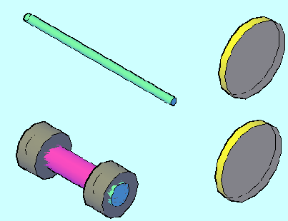
Continue:
As we see here we connect 2 rubbers cylinder at both sides of the plastic cylinder

Slide 48
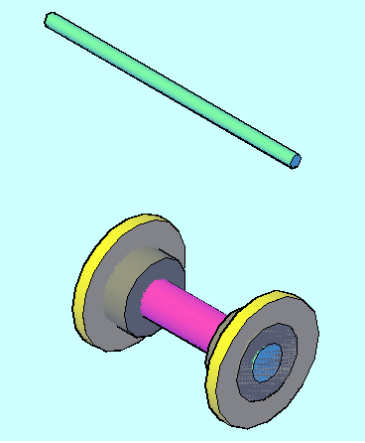
Continue:

Slide 49
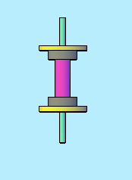
Continue:
Now we add 2 wood pieces
On the rubbers that exist on Both side of plastic pieces
As I mentioned before

Slide 50
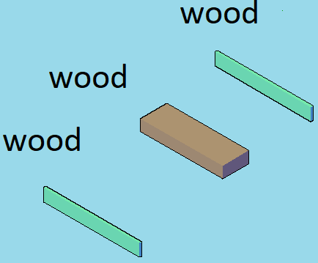
Continue:
Finally, we add metal piece in the middle of plastic piece, and we got the wheel for the convey belt.

Slide 51
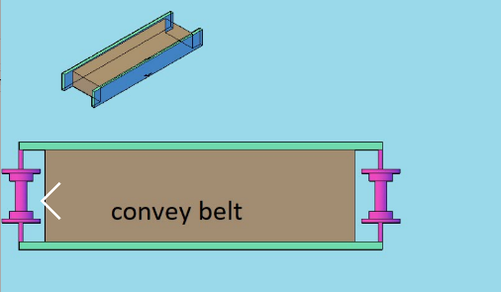
Continue:
Here we can see the last components of convey belt
Which is 3 pieces of wood

Slide 52
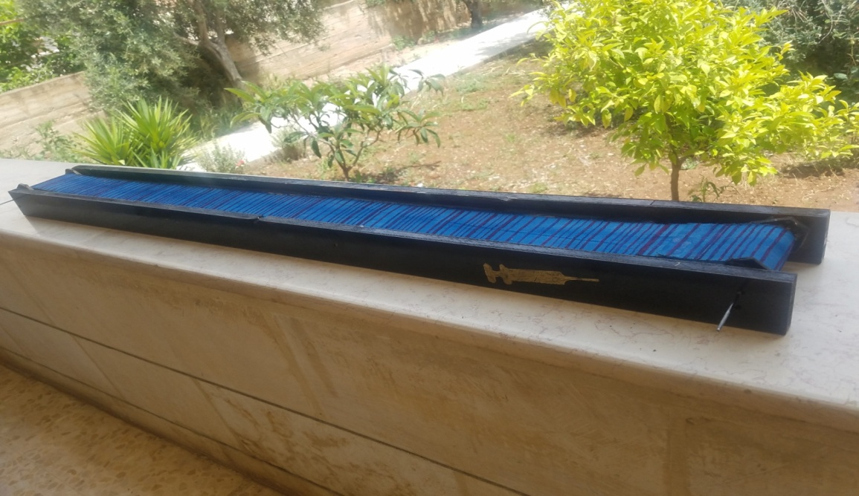
Continue:
Now we connect 3 pieces of wood with each other
Then we can add 2 wheels on both side of convey belt as you can see in the picture above.

Slide 53
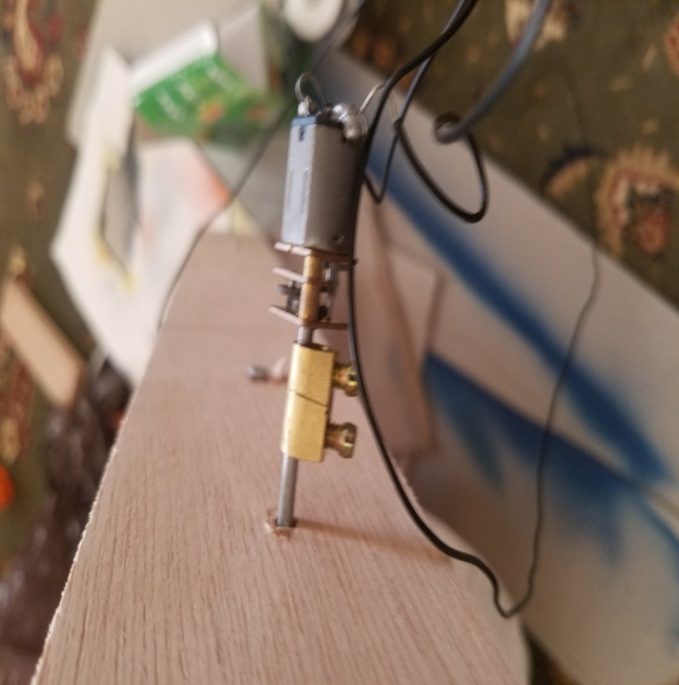
then use a cloth and connect it between the two wheels as above
and to the final step connect the motor to the metal cylinder using the motor gearbox as shown below .

Slide 54
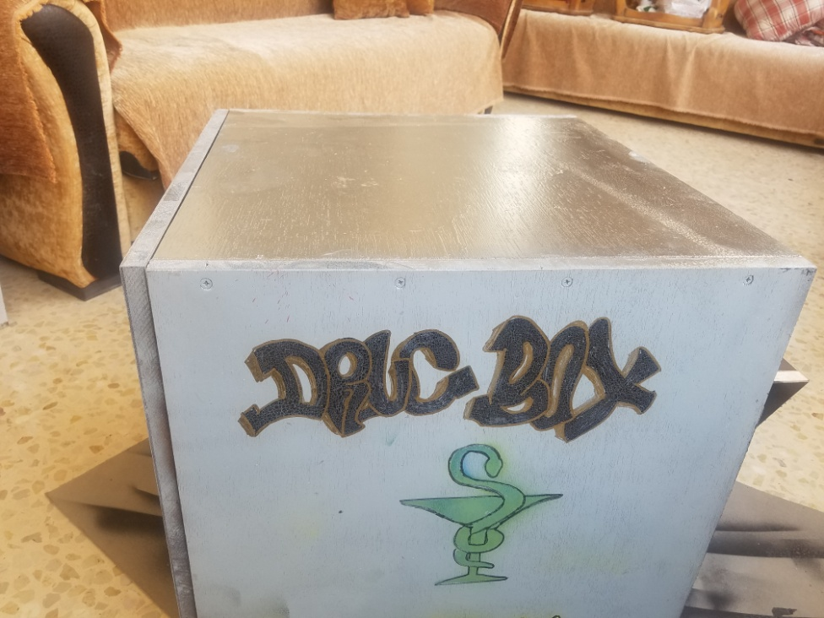
and then we move to implementation of the drugs box.

Slide 55
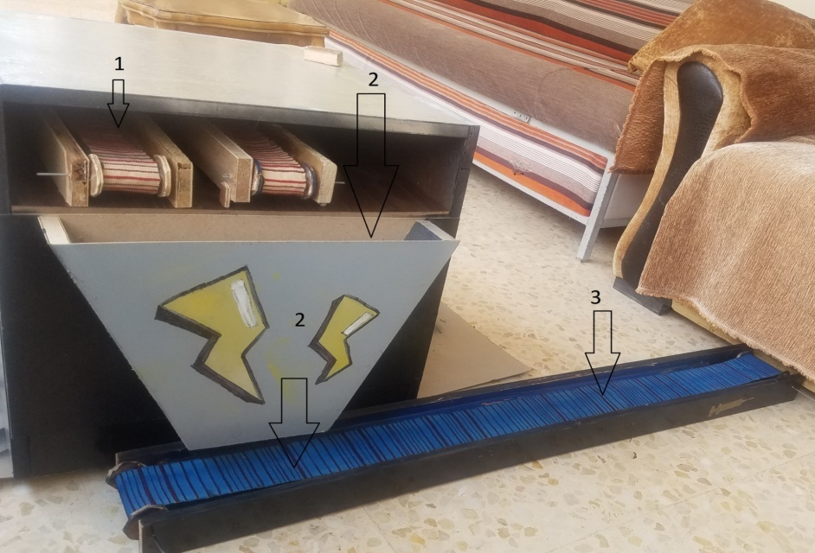
1-we put the medicine on the conveyor belts inside the box then the doctor chose the medicine throw the app .
2- the chosen medicine will be dropped from the box to the blue conveyor belt .
the blue conveyor belt will take it to the patient
***EVREY CONVEY BELT COST 6JD FOR EACH***

Slide 56
Problems:
Our motor couldn’t afford the arm-wood that weight 2kg so we use convey belt to solve this problem
The last problem :every time we link the motor with spring and we turn it on the medicine pill stuck in the spring so we have to find another way ,then we found that convey belt was the best way to solve this problem

Slide 57
Continue:
The Bluetooth chip was working normally then it burns ,why???
Because its only work on 3.3 voltage and in the first time we turn it with 5 voltage ,so we need to reduce voltage form 5 to 3.3 ,how we can do that ???
By using this formula:
VrxBluetooth ={R1/(R1+R2)}*V
VrxBluetooth={4.7k/(2k+4.7K)}*5=3.34v
Error Calculation=(V-VrxBluetooth)/VrxBluetooth
=(3.34-3.3)/3.3
=1.2%

Slide 58
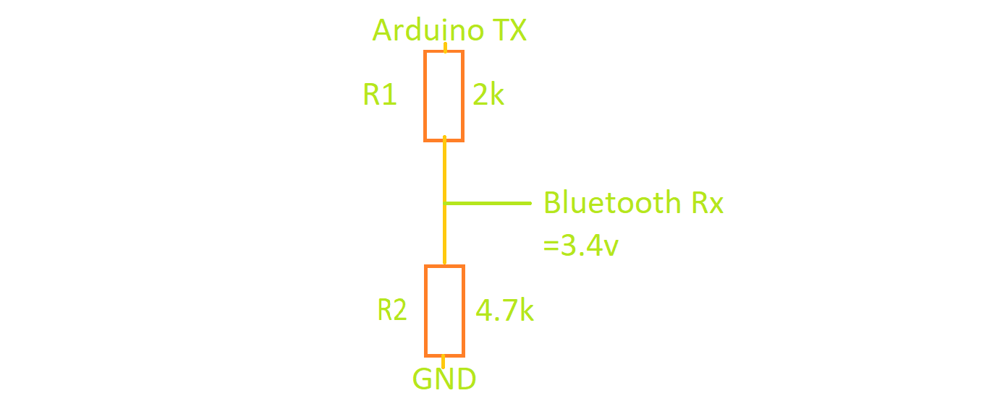
Continue:

Slide 59
Detailed System Design:
First, we need to connect Arduino board with Bluetooth chip which has 4 pins
we connect TX pin of Arduino board with 2k and 4k resistances, then connect RX pin that exist on Bluetooth chip between 2 resistances (2k,4.7k), now connect GND pin for the board with 2 resistances(2k,4.7k)

Slide 60
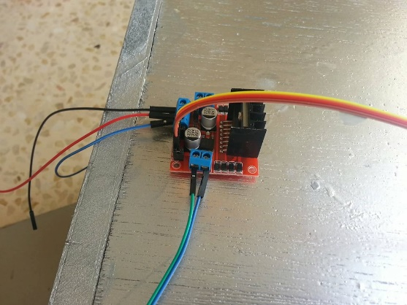
H-bridge connection:
We have 4 wires which help us to mange the that connected 2 motors that exist on the left and right side which connected with h-bridge through another 4 wires 2 for each motor .
This 4 wires takes signal 5v from the Arduino , the other 4 wires that connect motors with h-bridge gives 12 v for each motor, Arduino gives current 40mA,and h-bridge gives current 0-36mA
We also have 3 wires that connect with h-bridge through 2 pins ,the first one gives us 12v,the other is ground ,on of them is ground for 12v and the 2nd one is ground for 12v.

Slide 61
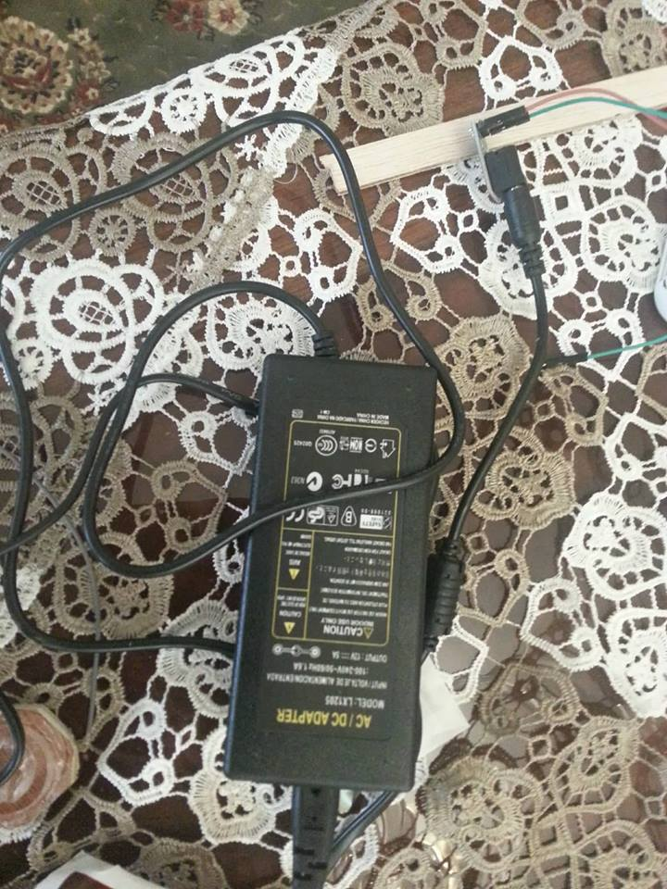
Please add suitable title
power supply is input for h-bridge ,the voltage output 12v is connected to voltage input(vin12v) for h-bridge

Slide 62

Question:

